Slide 1


Project Presentation
Data Analytics/ Joemon Jesudas
12-Oct-2022

Slide 2
About Me
I started my career at Allianz as a fresher on May 2022, with much aspiring dreams. And the journey so far has been really motivating, inspiring and educating.
I come from Kottayam, and have completed my Masters in computer Science with Specialisation in Data Analytics in 2022

Slide 3
My Roadmap
Month 5
Client Projects:
1. GIAM Auth Access
2. RTA Modelling
Month 4
1. Use Case #2 - Car Damage Detection
Month 3
1. Hands on KT
Month 2
1. KT Sessions
Month 1
1. Induction session.
2. Use Case #1 - Credit Risk Prediction

Slide 4
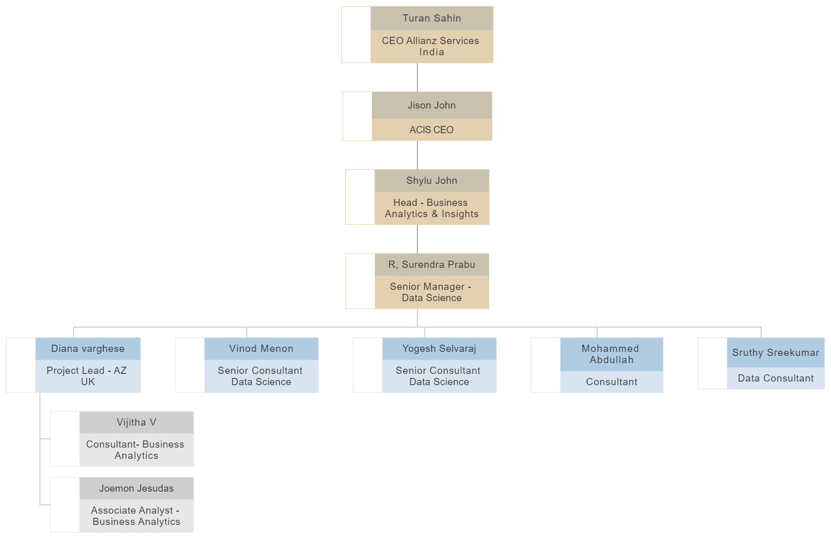
Org Chart - Team

Slide 5
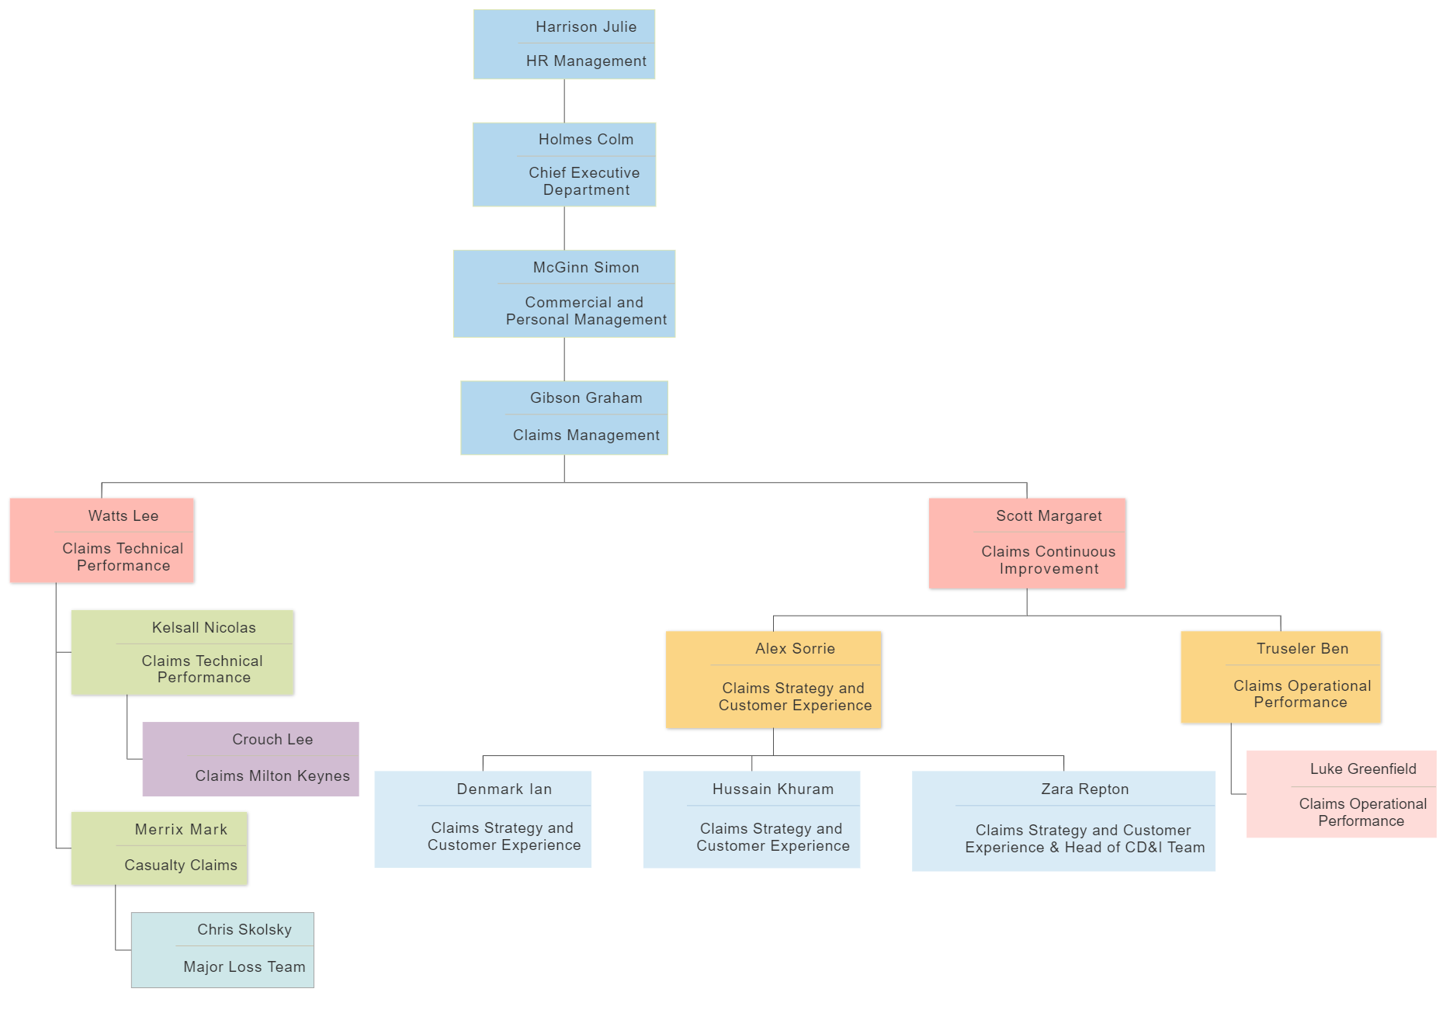
Org Chart - Customer

Slide 6

Credit Risk Prediction
The aim of this use case was to classify credit risk by a set of attributes as good or bad credit risks.
The dataset was based on German credit data from UCI Portal
Different classification algorithms were used such as:
Model | Accuracy
XgBoost | 92 %
Random Forest | 83 %
KNN | 74 %

Slide 7
Grafana Dashboard
The aim of this work was to re-create all the visualizations of credit risk dataset in Grafana dashboard.
The workflow involves:
1. Converting the .csv file to sql tables.
2. Create new database in postgress and load created table.
3. Select the Datasource in Grafana as postgres and load the created table
4. Created visualizations in Grafana using query language.

Slide 8
Car Damage Detection
Developed a web app for detecting and segmenting damaged areas in car images.
The model used was keras Sequential model with 9 convolutional layes.
Front-end was built using the python library called Streamlit.
Linear Regression model was used to predict the cost of the damaged area of a car.

Slide 9
1. GIAM Authorization Access
Create a GIAM group which contains the access to the Quantum Web App.
To access quantum web app, user should be added to the GIAM Group.
2. A/B Testing For Outlier Cases.
Difference Between FSP and COA > 5000 --> Outlier(manual reference)
70% of the claims is given for manual reference and 30% of claims is model prediction.
3. Audatex Dashboard Refresh
Aim of this dashboard is to find inflation in cost of repair of vehicles with respect to previous quarter.
ACPC increase is also calculated with respect to previous year same quarter.

Slide 10
RTA Modelling
Objective & Background
RTA claims was created with the intention of reducing the cost of making and processing a personal injury claims and to manage the whole process in a more efficient and time effective manner.
The Road Traffic accident claims are processed through the MOJ portal
Earlier it handles claims to the value of between 1000£ to 25000£
Now any claims with the value less than 5000£ is processed through OIC portal.

Slide 11
DATASET:
1. Claims captured at CNF level
2. Settlement Date (2017 to 2022)
3. Settled general Damage > 5000
4. Stage 2 settled claims
5. Non- Minor Claimants.
Model Overview
Dataset contains 848 records.
Gradient Boosting Regressor was used to build the model.
Accuracy of the model was 78%.

Slide 12

Competitor for Allianz
Company | About
1) AXA | French Multinational Insurance Company headquarted in Paris, France. AXA provides Investment Management and other financial like insurance, Life Insurance etc...
2) AIG | Is an American multinational finance and insurance corporation headquarted in New York. AIG provides wide range of property casualty insurance, life insurance, retirement solutions and other financial services to customers
3) AVIVA | Bristish multinational insurance company headquarted in London. In UK, AVIVA is the largest general insurer and leading life and pension provider. AVIVA have 98% claims settlement ratio.

Slide 13
Thank you ...

